Slide 1
The Lottery
By Shirley Jackson

Slide 2
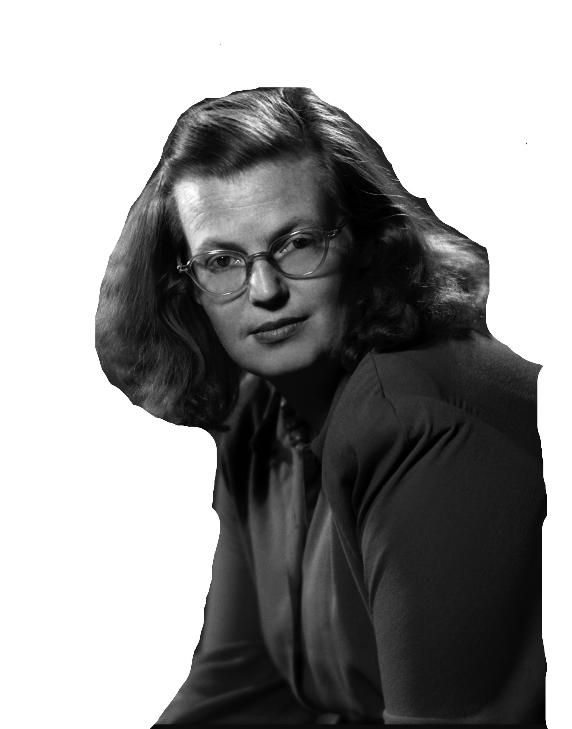
Shirley Jackson
Super weird lady
Born Dec. 14, 1916
Died Aug. 8, 1965
Became a RECLUSE when she started gaining notoriety for her writing
One of the most influential suspense and horror authors

Slide 3
The Lottery
Themes
Published in 1948
Controversial, but also made Jackson famous
“One of the most famous short stories of American Literature”
Based on the title, write down a few ideas of what you think the story’s theme will be.
Tradition
American Values
Scapegoat
Mob Mentality

Slide 4
Literary Devices
In your groups, spread out the papers with the terms below at your table. Using the stack of index cards with words on them, place the cards under the associated term.
the sequence of the story
the emotional effect
the attitude of the author or character
the opposite of what is expected
the tension involved in what is about to happen in a story
Plot
Mood
Tone
Irony (situational)
Suspense

Slide 5
Situational
Verbal
Dramatic
Has to do with ACTION
When the opposite of what is expected happens
EX: A fire station burns down.
Has to do with WORDS
When what you say is the opposite of what you mean
EX: “I LOVE reading in Ms. Hanley’s class” says the person who hates reading.
Has to do with KNOWLEDGE
When the audience knows something the characters do not
EX: Seeing the killer in a horror movie behind the main character.
https://youtu.be/WFPJMBh42_A
https://youtu.be/2LNG1ySVsl4
https://youtu.be/K0-sRzqRCic

