Slide 1
Take Cornell Notes on the following PowerPoint!

Slide 2
Richard Connell
American Writer
Oct 17 1893 - Nov 22 1949

Slide 3
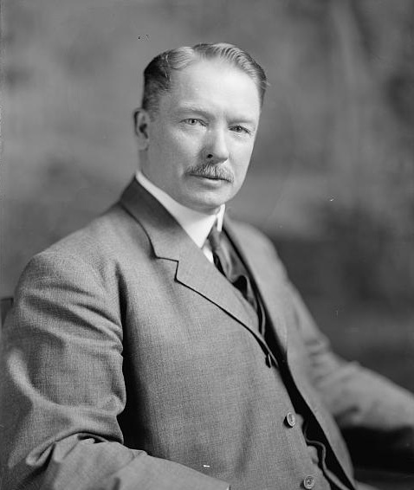
Life
Born in Poughkeepsie, New York
Died Beverly Hills, CA
He became a sports writer at the age of 10!
Served In WW1
Attended Harvard University
15 movies were made from his stories

Slide 4
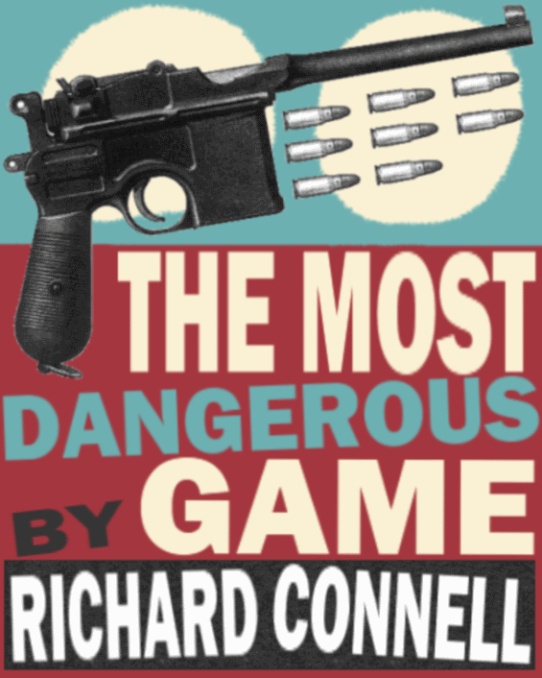
The Most Dangerous Game
Published in 1924
Originally a Periodical
Adapted for film 8 times
Adapted for radio 3 times
Adapted for TV and in various well-known TV series 21 times
Adapted in video games 3 times
The Zodiac Killer and the serial killer Robert Hansen are both real-life parallels to the story

Slide 5
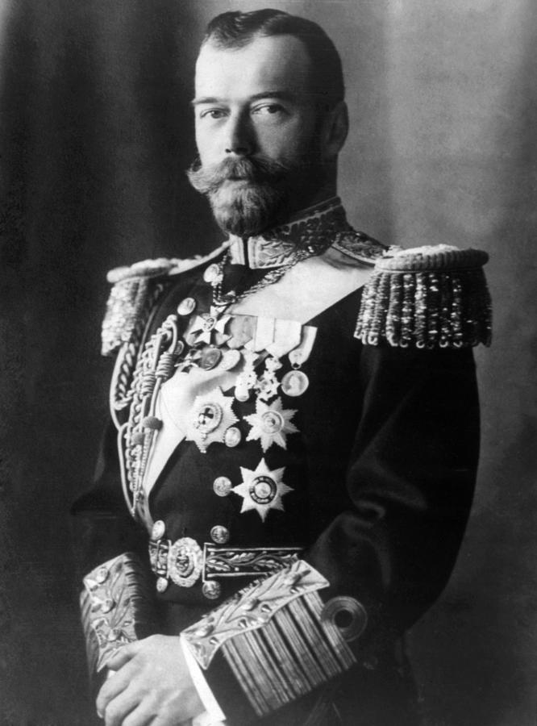
Historical Context
The Russian Revolution of 1917
Cossacks - fierce, bloodthirsty, privileged soldiers who are unwilling to acknowledge that the rules of ordinary people apply to them.
Two characters in the story are Cossacks; when the ruler of Russia, Czar Nicholas II was overthrown, Cossacks were executed or exiled.

Slide 6
Internal Conflict vs. External Conflict
Conflict is a struggle between opposing forces. It is the engine that drives that plot of all stories.
Internal Conflict – occurs when a character grapples with his or her own opposing feelings, beliefs, needs, or desires
External Conflict – occurs when a character clashes with an outside force, such as another character, society, or nature

Slide 7
Other types of Conflict
Man vs. Man - The central character faces opposition from another person or group of people.
Man vs. Self - The central character faces an internal struggle (internal conflict).
Man vs. Society - The central character or group of characters battles against traditions, institutions, or laws.
Man vs. Nature - The central character struggles against animals, the elements, or other natural forces.

Slide 8
Group Discussion
Share notes and see if there is something interesting someone else put
Are there any facts that interested you?
Make Predictions:
Will you like this story?
Will you hate this story?

Slide 9
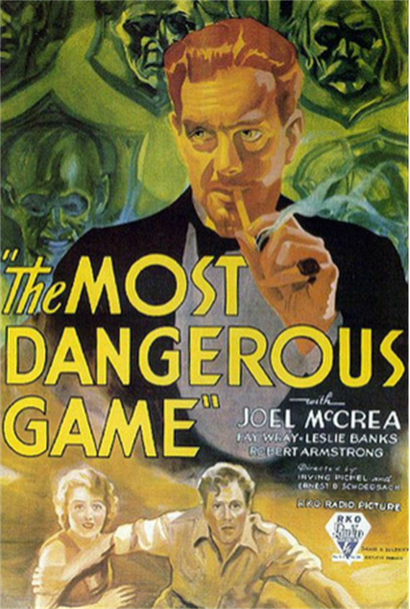
In three to four sentences, summarize your Cornell Notes about Richard Connell and “The Most Dangerous Game.”

