Slide 1
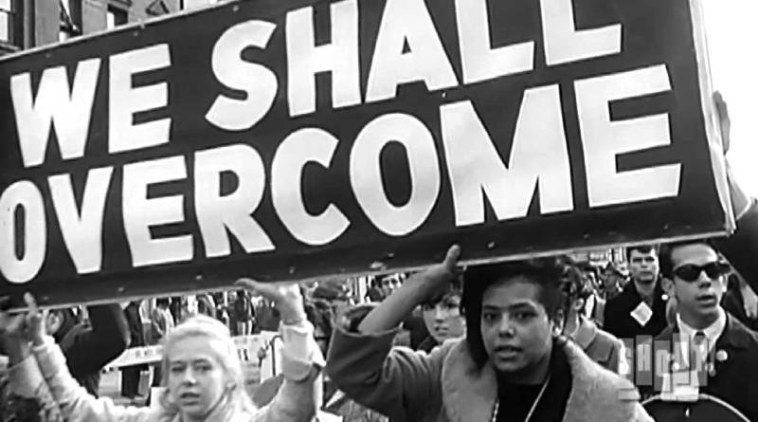
The Civil Rights Movement
1954 - 1968

Slide 2
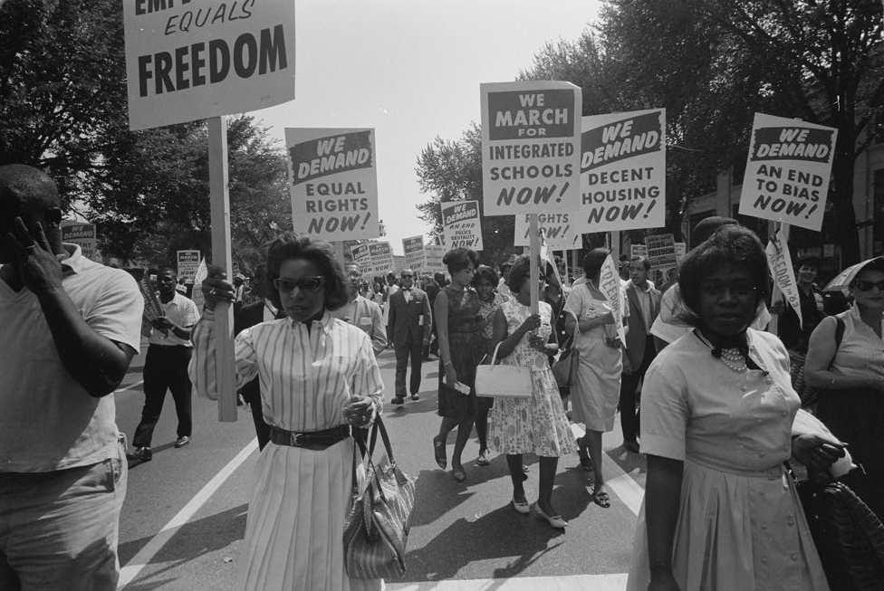
The Civil Rights Movement
Struggle for social justice
Fighting against discrimination towards the Black community
Racial discrimination:
Education
Employment
Housing
Military service
Voting

Slide 3
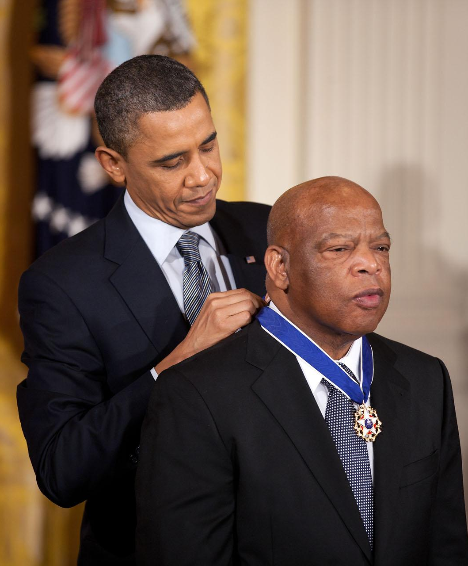
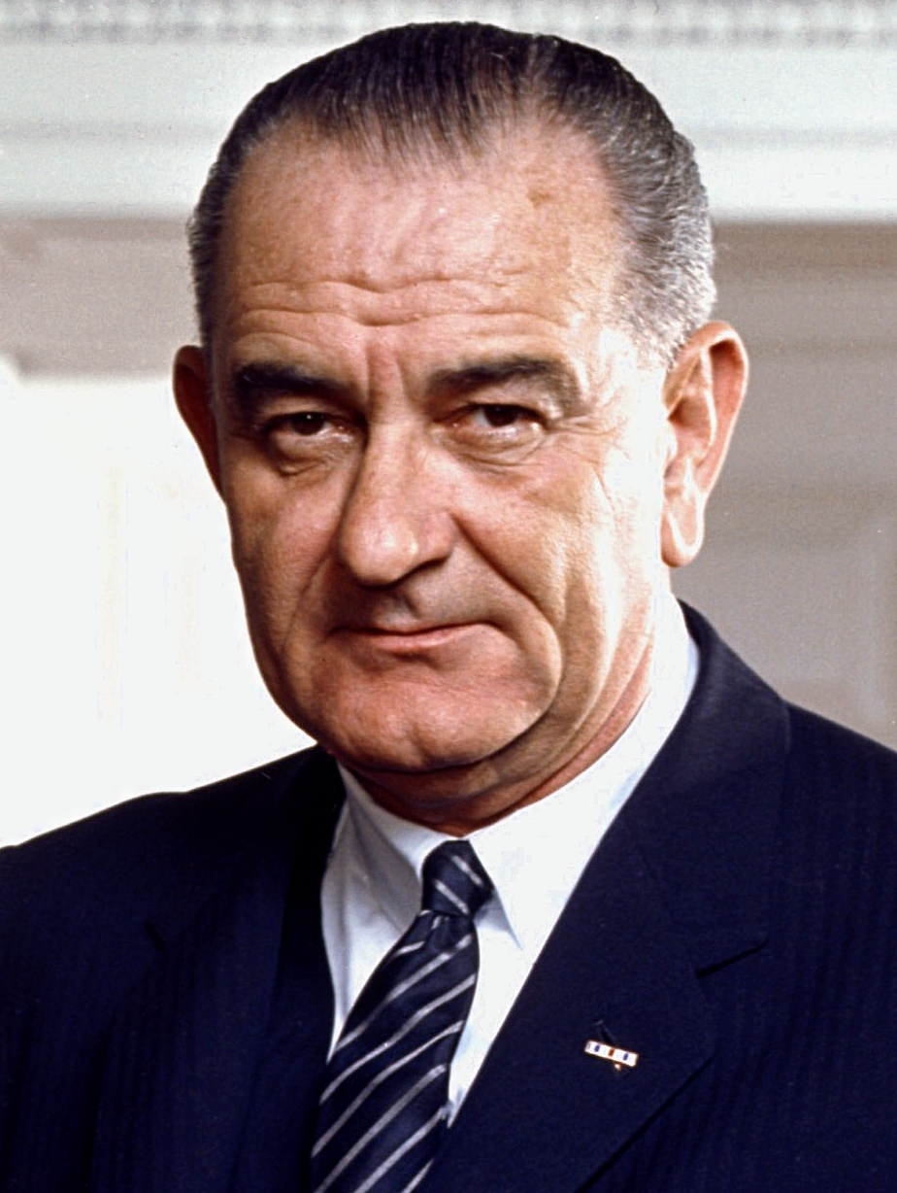
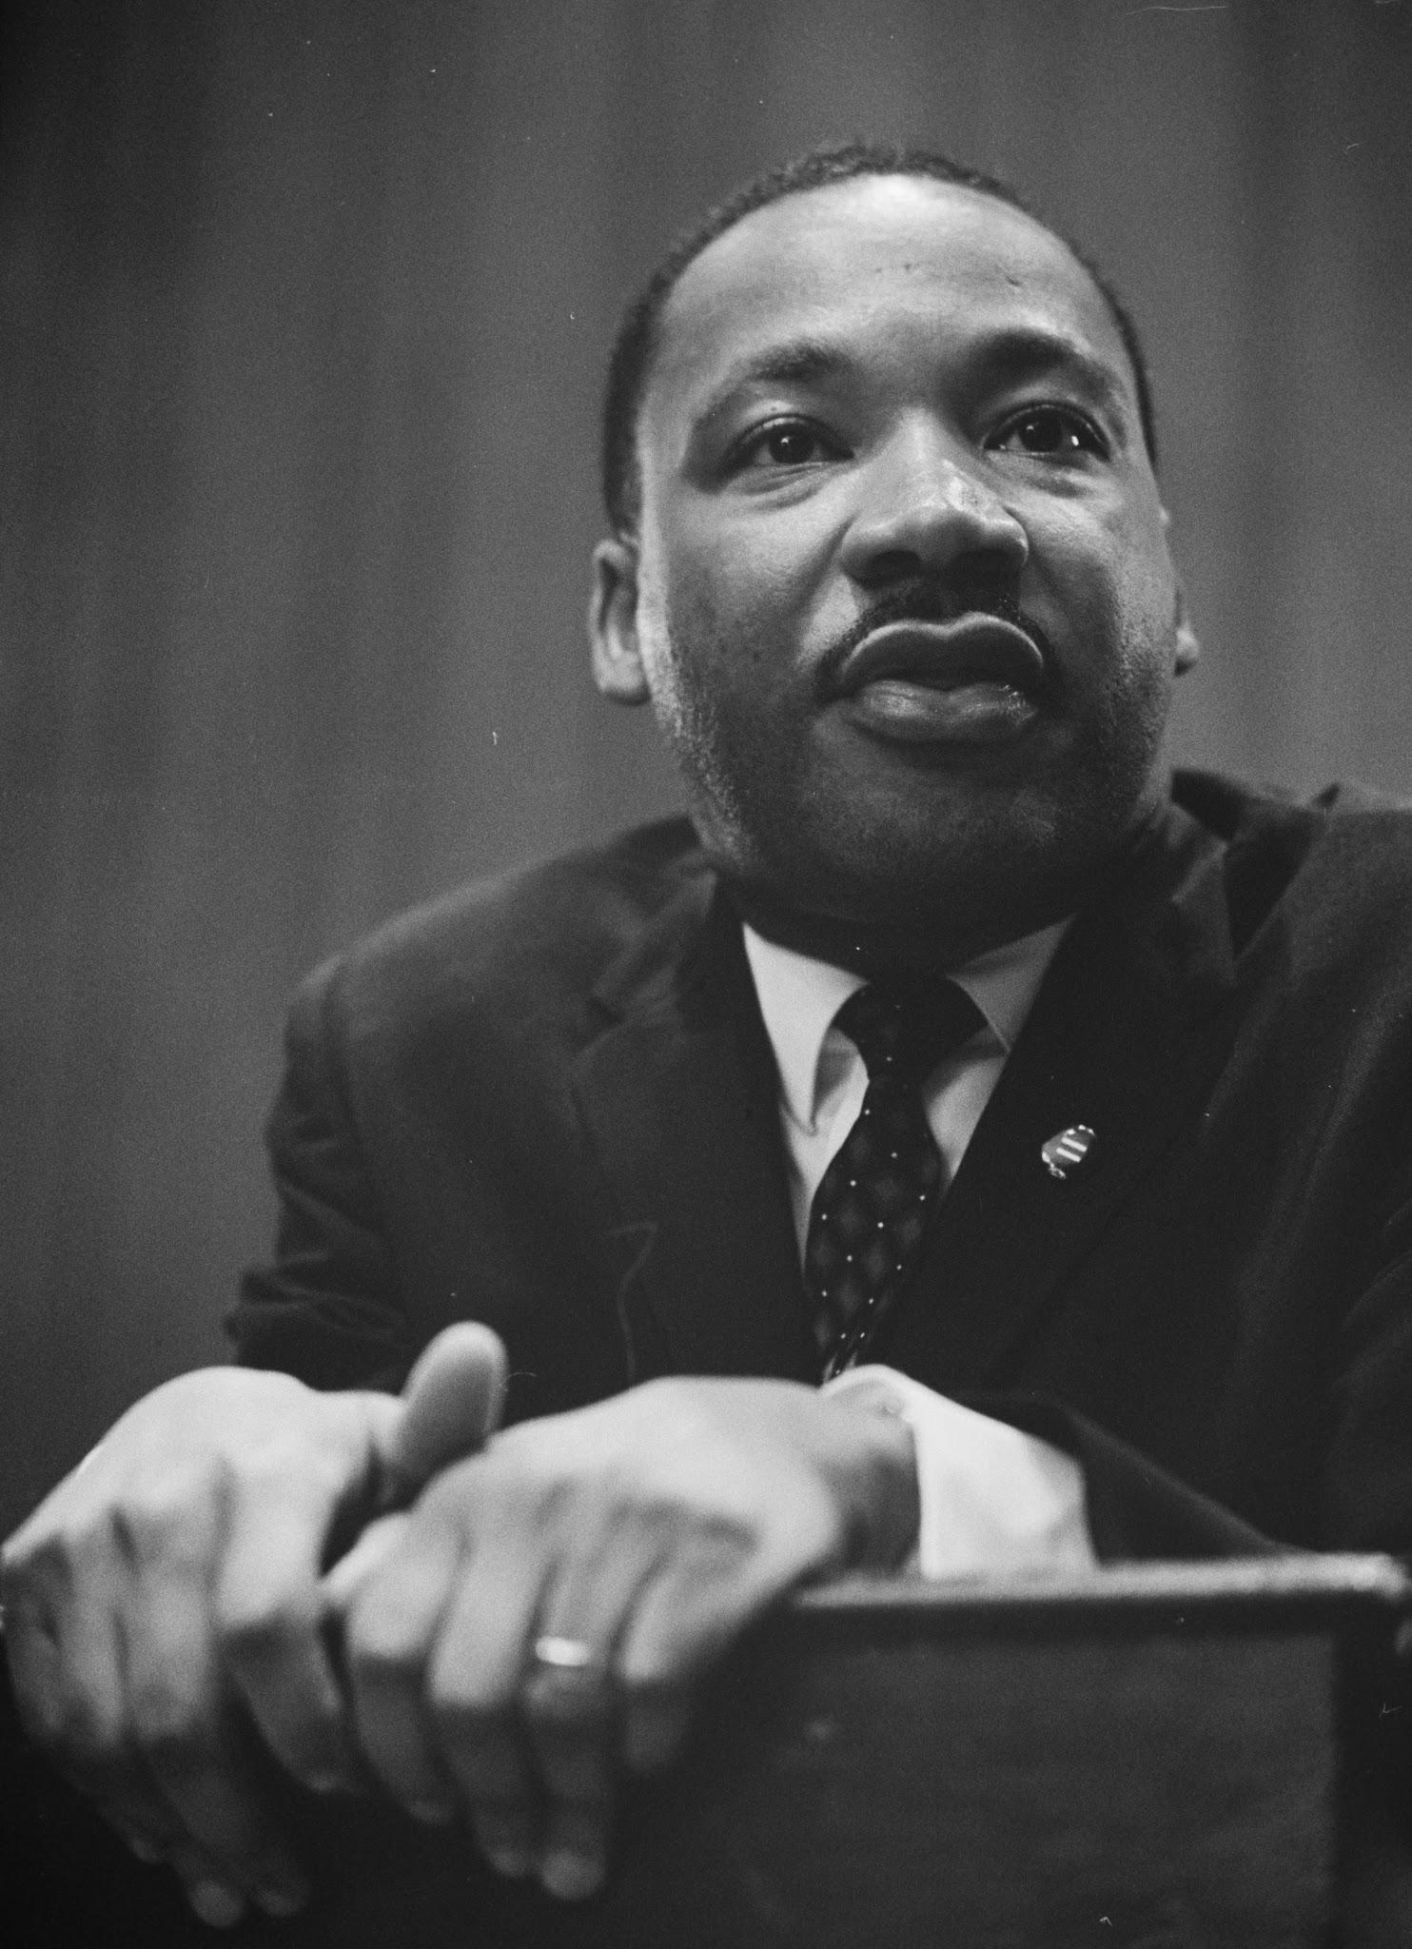
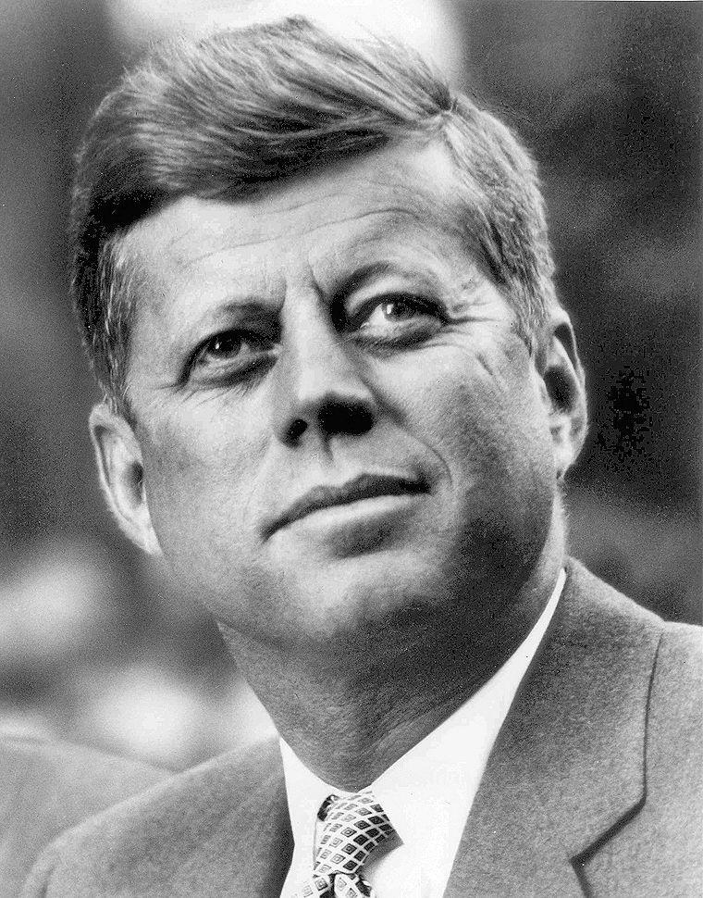
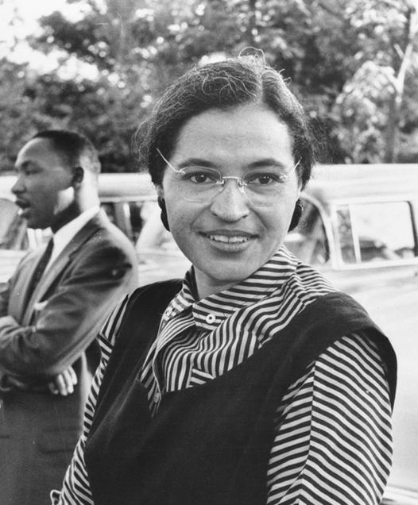
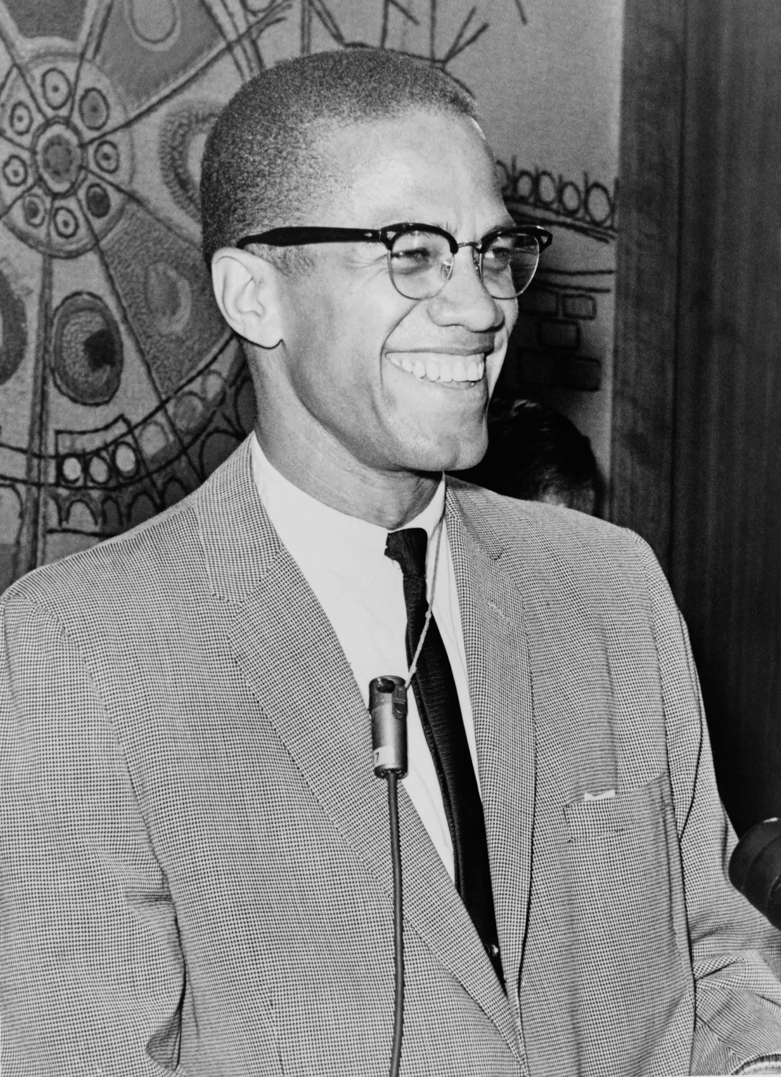
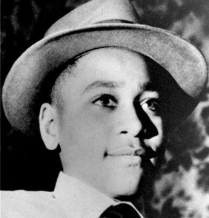
The Civil Rights Movement 1960s
Most politically active and dramatic decades of history
Two main trigger events
The Death of Emmett Till (Aug. 28, 1955)
The Arrest of Rosa Parks (Dec. 1, 1955)
Led to sit-ins, protests, marches
President: John F. Kennedy (assassinated Nov. 22, 1962)
Vice President: Lyndon Johnson
Prominent Leaders: Martin Luther King Jr., Malcolm X, John Lewis

Slide 4
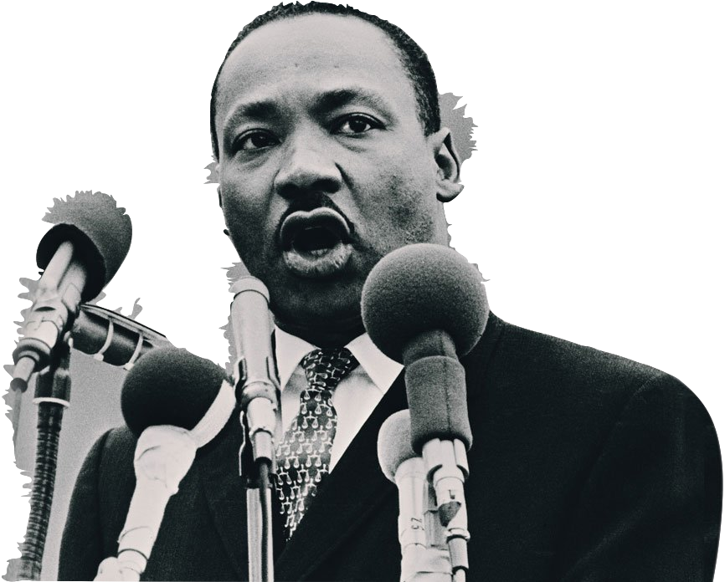
“I Have a Dream”
By Martin Luther King Jr.
April 28, 1963

Slide 5
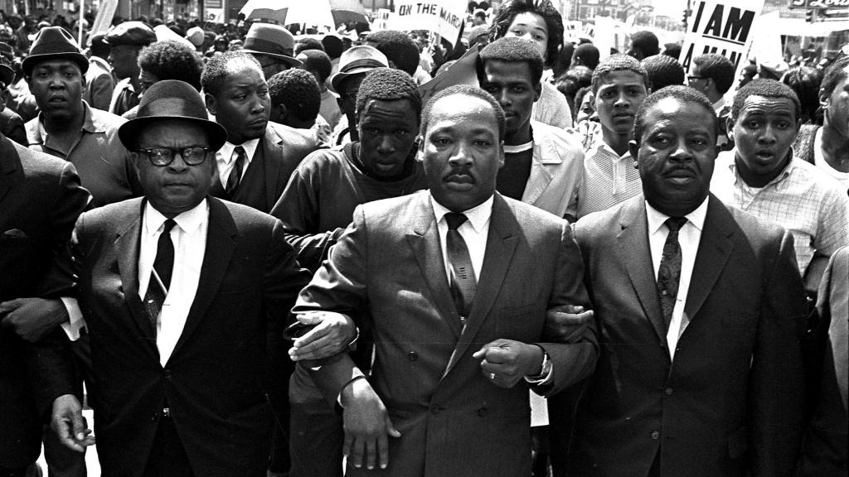
RAMP
Role: Political Speaker
Audience: Government
Mode: Argumentative/ Inspirational
Purpose: To Persuade, To sign the Civil Rights bill

Slide 6
Persuasive Techniques
Impact
Location: Outside the Lincoln Memorial
Rhetorical Devices:
Repetition
Analogy
Restatement
Parallelism
Allusion
One year after King’s speech, the Civil Rights Act was passed by congress
250,000 people
Continuous Marches & Sit-ins
King was assassinated in Memphis, Tennessee in 1968

