Slide 1
How to analyze a writing prompt

Slide 2
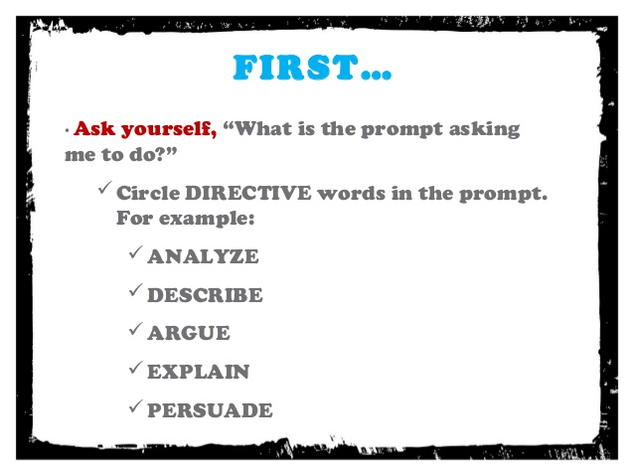

Slide 3
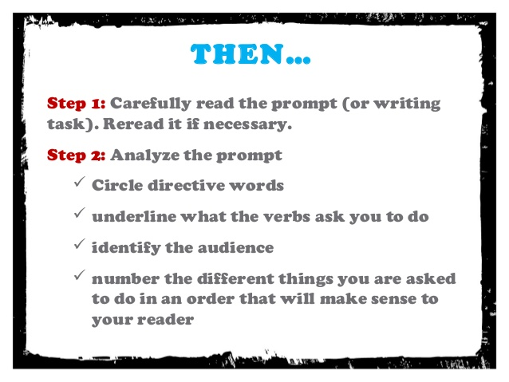

Slide 4
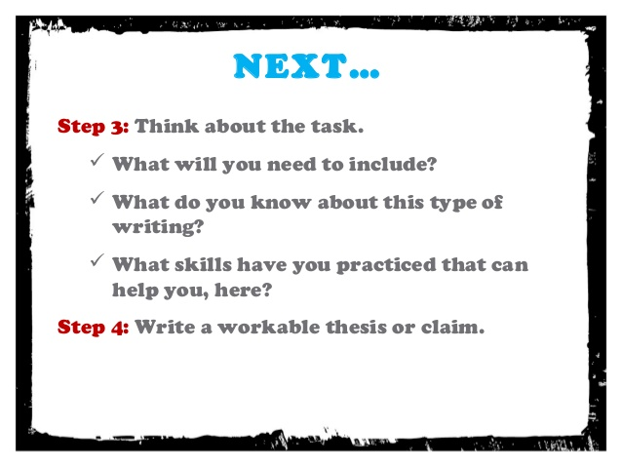

Slide 5
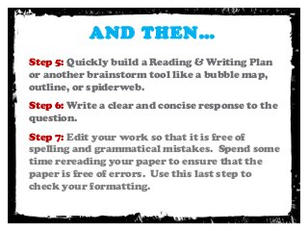

Slide 6
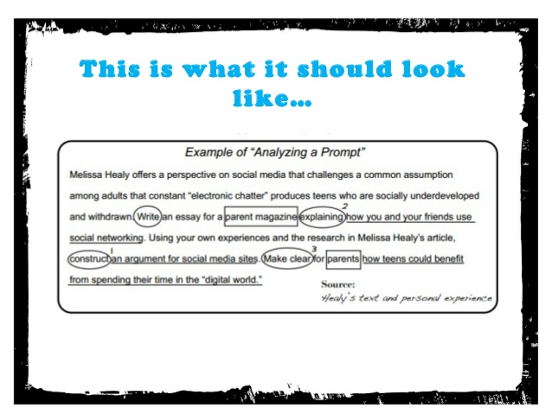

Slide 7
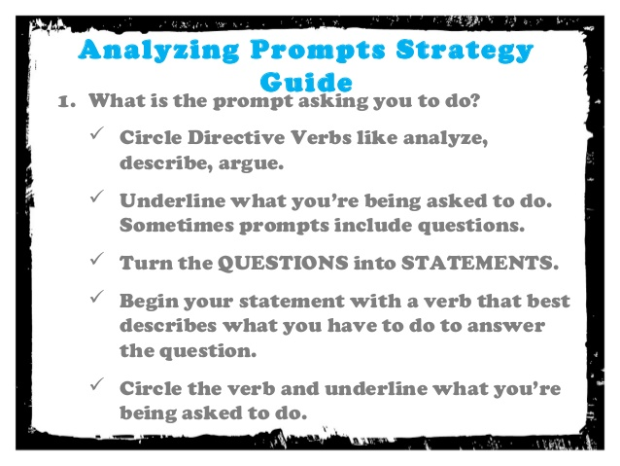

Slide 8
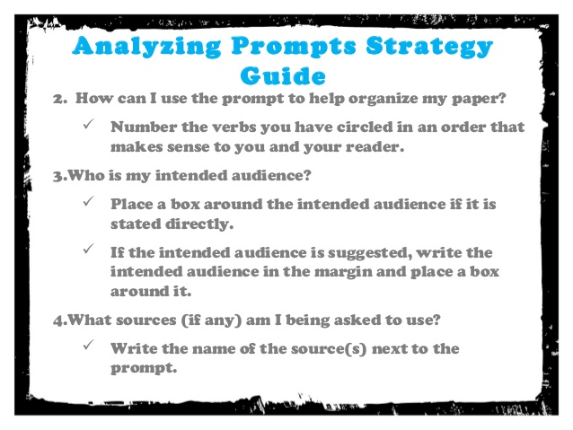

Slide 9
Prompt Practice
Break down each prompt on the practice sheet
  Circle the verbs that tell you what to do
  Place a box around the intended audience
  Underline what you are supposed to do
Once you have marked up your prompt, write which type of essay you would be doing (Informative or Argumentative) and what the essay is going to be about

