Slide 1
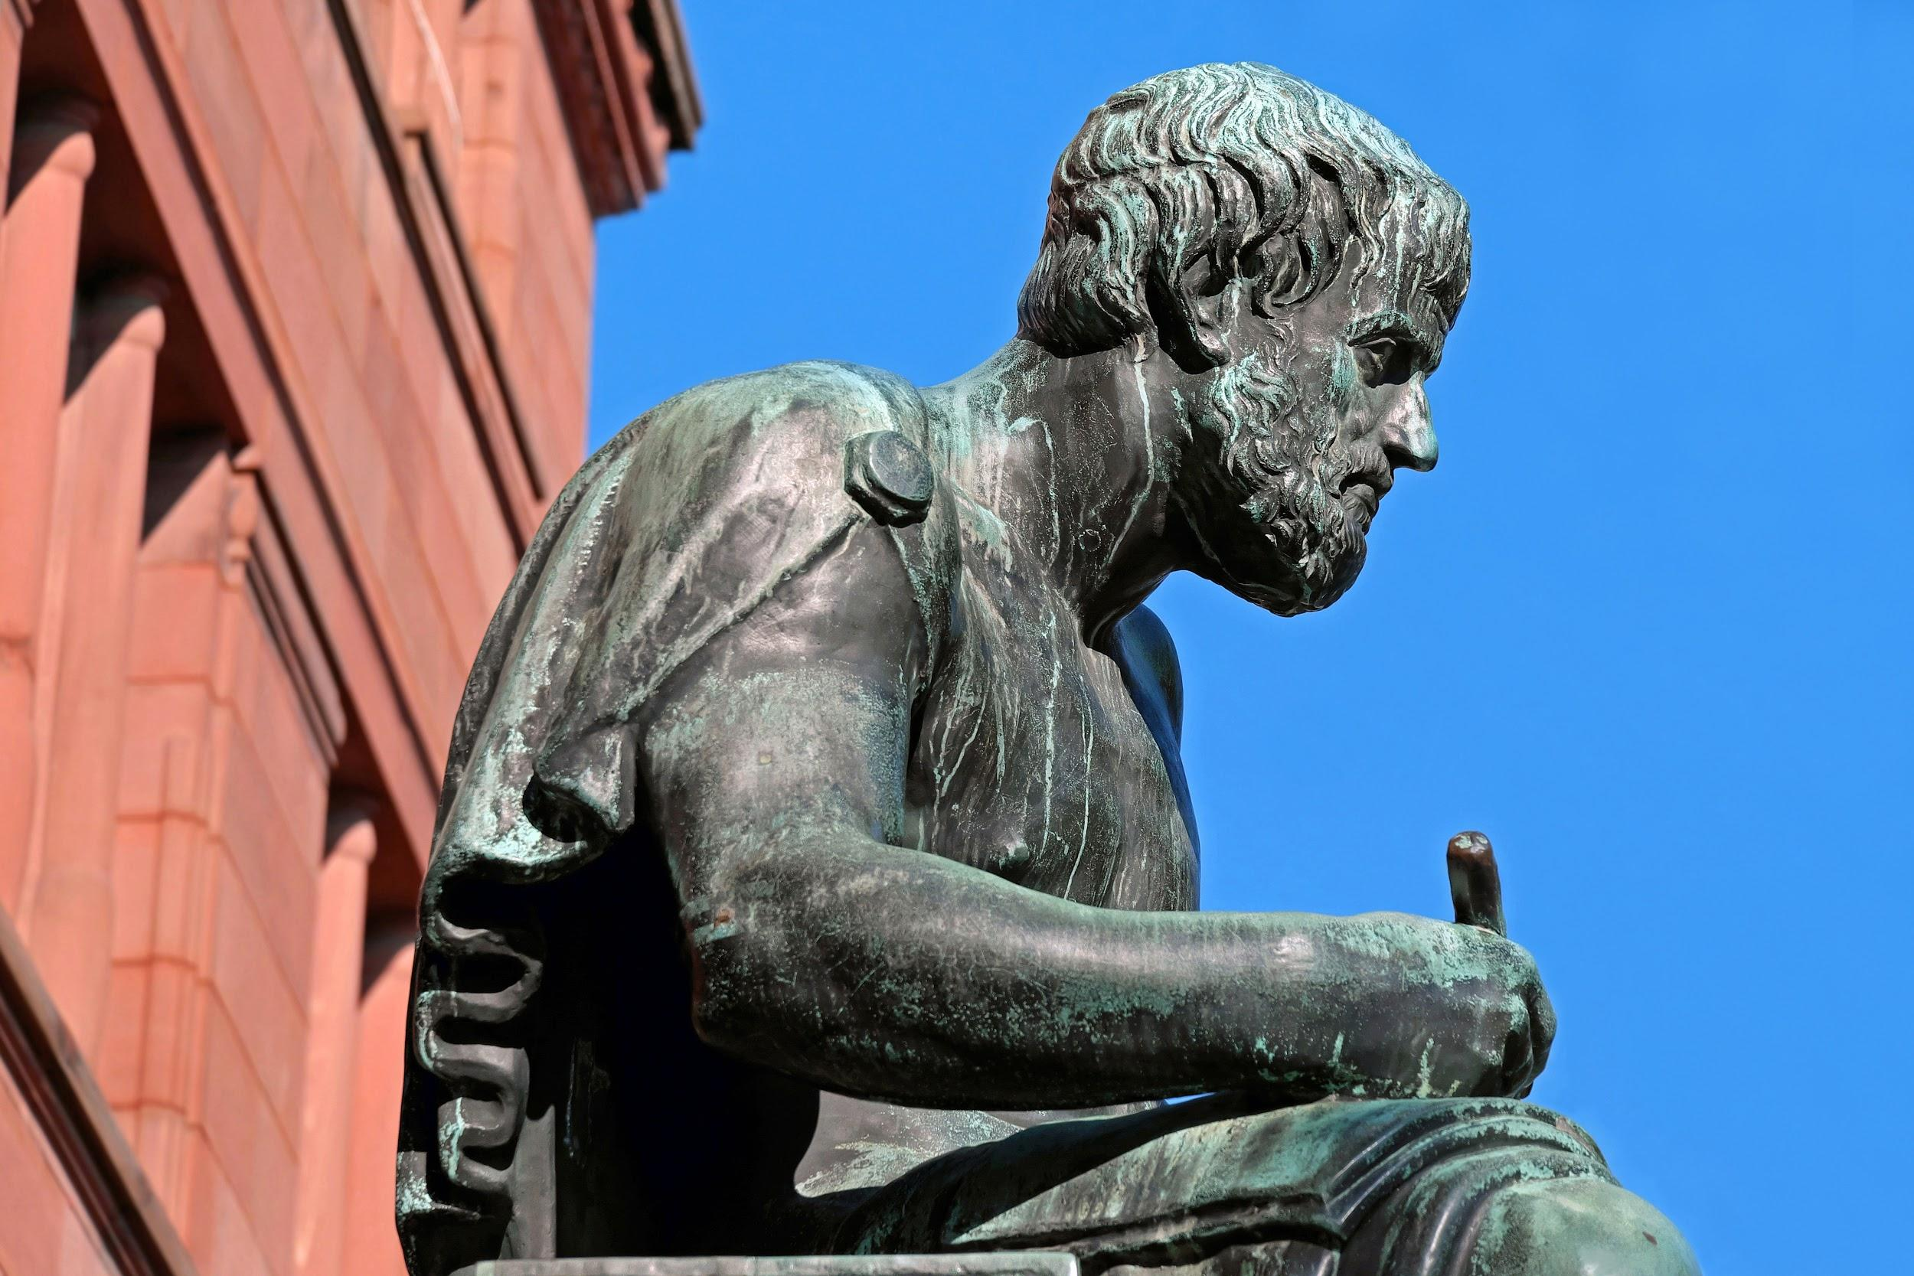
The Aristotelian Appeals
Ethos
Pathos
Logos

Slide 2
Ethos
Pathos
Logos
Arguments based on ethics, morals, values, and beliefs.
Ethics, Ethical
Pathetic, Empathy, Apathy, Sympathy
Arguments based on logic, facts, statistics, evidence from academic authorities.
Arguments used to induce emotion from the audience; fear, love, sadness
Logic, Logical

Slide 3
Ethos
“[The writer] creates the impression that (s)he is a person of sound sense, high moral character, and benevolence/good will” (1).
Credibility - the author’s knowledge of the subject, expert judgement, and logical perspective.
Moral Character - the author’s ability to choose right from wrong and respect of common values.
Good Will - the author’s likability and trustworthiness.
https://youtu.be/3ujWLyuGysM

Slide 4
Pathos
The writer appeals to the audience’s emotions like, fear, sadness, duty, hope, and patriotism (2).
Using personal anecdotes
Characterizing in a positive or negative way (“good” “bad”)
Imagery, Simile, Metaphors
Using objects with an emotional subtext (people, pets, ideas, symbols)
https://youtu.be/wc1TrKIzAJM

Slide 5
Logos
The writer appeals to the audience’s reason and logical thinking.
Presentation of the Argument - cause-and-effect, chronological, deductive/inductive reasoning, analogy.
Presentation of the Evidence - citation from expert, scientific studies, statistics, classifications and definitions.
https://youtu.be/0ATwnTHoH9A

Slide 6
Ethos
Pathos
Logos
Ethics, Ethical
Pathetic, Empathy, Apathy, Sympathy
Logic, Logical

Slide 7
References
UNM. “The Aristotelian Triad (The Rhetorical Appeals)” Unm.edu. 19 Oct 2018. Retrieved from http://www.unm.edu/~exa10/The%20Rhetorical%20Appeals.htm
Ibid.
Universal Pictures. “Evan Almighty” 19 Oct 2018. Retrieved from https://www.youtube.com/watch?v=3ujWLyuGysM&feature=youtu.be
Universal Pictures. “Mean Girls” 19 Oct 2018 Retrieved from https://www.youtube.com/watch?v=3ujWLyuGysM&feature=youtu.be
Obama, Barack. “Remarks by the President in Address to the Nation on Syria” 10 Sept 2013. Retrieved from https://obamawhitehouse.archives.gov/the-press-office/2013/09/10/remarks-president-address-nation-syria
Invisible Children. “KONY 2012” 5 Mar 2012. Retrieved from https://www.youtube.com/watch?v=Y4MnpzG5Sqc

